Slide 1
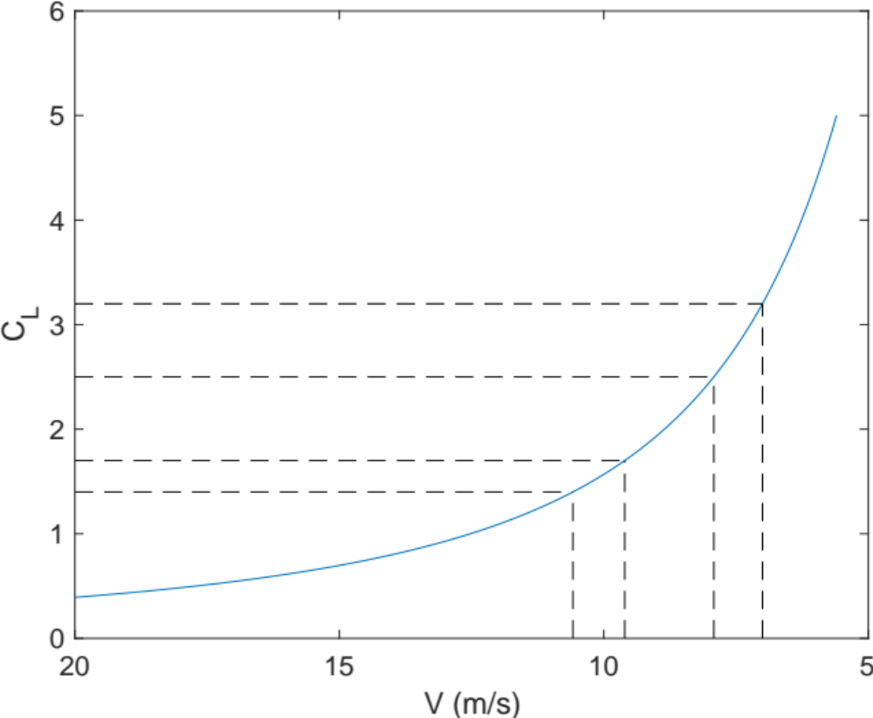
Deceleration Profile
𝜶: 29°
𝜹_{F}: 40°
𝜹_{E}: -10°
Thr: [0, 53%, 53%, 53%]
Boxes show elevator, angle of attack, and trim settings required for steady level flight.
𝜶: 22°
𝜹_{F}: 40°
𝜹_{E}: -17°
Thr: [0, 49%, 49%, 49%]
Wind Tunnel max dCJ
Throttles are shown for the left wing only, from tip to fuselage. The right wing is assumed to be symmetric.
𝜶: 17°
𝜹_{F}: 40°
𝜹_{E}: -19°
Thr: [0, 39%, 39%, 39%]
Unblown Stall
Clean Stall
𝜶: 15°
𝜹_{F}: 40°
𝜹_{E}: -28°
Thr: [44%, 0,0,0]
OR
𝜶: 10°
𝜹_{F}: 40°
𝜹_{E}: -21°
Thr: [0, 33%, 33%, 33%]
𝜶: 2.5°
𝜹_{F}: 0°
𝜹_{E}: -9°
Thr: [65%, 0,0,0]
𝜶: 15°
𝜹_{F}: 0°
𝜹_{E}: -28°
Thr: [45%, 0,0,0]

